Slide 1

Towards Professionalization of Health sector Leadership, Management and Governance
About HeSMA
Secretariat

Slide 2
Health sector aspirations
Kenya and East Africa aims at strengthening Health Sector Perfomance through Systems Approach (Public/Private)
Through collaboration and partnerships arrangements the MOH seeks towards building a culture of adherence to code of conduct and professionalism
Focus is on funding and sustaining UHC

Slide 3
How is Health Sector Perfomance Strengthened!
Effective health leadership
Strenthened health Stewardship
Improved health Governance Systems
Partnership consolidations

Slide 4
Strengthened Health Management/Leadership
The players
National: The cabinet secretary for health, the ministry of health principal secretary, Director General, Directors of Medical services and the Afya House departments heads (Corporations and regulatory bodies Chief executive officers)
County Level: The County Health Executive, County Chief Officer of Health, County director of health and the county Health Management Teams including heads of department
Health Facilities: Medical Sups, Hospitals Administrators and Departmental/sectional heads and In-charges
Training Institutions: Universities, Kenya Medical training College and other tertiary colleges and institutes
Public and FBOs: The Chief Executive Officers, Directors, Line Managers, department heads and supervisors and coordinating teams
NGOs: Chief Executive Officers, Supervisors, Managers and team leaders.

Slide 5
Strengthened Health Governance
National: Parliamentary Health and associated committees, Cabinet and principal Secretaries
County: County Assemblies, chief Executive of health and the County Chief Officer of Health
Other stakeholders

Slide 6
Who are the healtcare managers
Middle- Senior level Healthcare Managers ; Medical Superintendents, Country Managers, Project Directors; Finance and Human Resource Manager/Director, Chief Executive Officer, General Manager, Facilities Manager etc.
Middle level Managers + Senior line managers: Clinical services directors, Nursing or Medical director; Medical Superintendents, Project Managers, Advisors. Strategic Information Manager
Middle Level Managers: Departmental In-Charge or Supervisor, Hospital Coverage Officers, Outpatient Managers, Coordinator,
Entry, Middle level Managers: Health coordinators, Shift In charges, medical records manager, Head of department, Laboratory Managers,
Cross Cutting; Health Coordinators, Country Managers, Project Directors, Strategic Information Manager, Finance and Human Resource Manager/Director, Medical records manager, Head of department, Laboratory Managers, Chief Executive Officer, General Manager, Facilities Manager, Hospital Administrators (HAOS)

Slide 7
What needs to be done to strengthen
What are the Priorities?
Identify HRH capacity gaps at National and County Level (already done by MOH)
Improve Leadership, Management and Governance through benchmarking, training, mentorship and rewards
Regulate and institutionalize
Professionalize health Governance Leadership And Management

Slide 8
Important Milestones
2012-2013 The idea of an association came up HeSMA was registered as a professional body through the technical support of Wambui Kyama and Co. Advocates on May 13, 2013
2013-2014 Research and consultation led by Rachel Onyango Waireri. Establishment of Capacity Development & Credentialing and Certification Committee. Conceptualized and put together HeSMA Management and Governance team including the Executive team. Strategic plan 2013-2017 drawn
2014-2017 Established MOU with Northeastern Unversity, Give Back Global, and IHF to support benchmarking of Health Systems Management. Collaborated with Health Systems Global and American College of Health Executives
2015 In partnership with the Ministry of Health, MSH, and other USAID programs, participated in the implementation of a leadership development program. Conducted the 2nd Health and Leadership program and organized all training institutions. Developed a road map to strengthen healthcare leadership development

Slide 9
2015-2016Countrywide Health Systems Assessment, development of the report, and presentation to the Ministry of Health Cabinet Secretary Dr. Cleopa Maillu. Hosted public lecturers in Kenyatta, Kenya Methodist, Moi Universities and met leaders of health in 20 counties in Kenya. Development of action plan and conceptualization of programs
2016-2017Developed key framework and tools for professionalization and institutionalization of health leadership, management, and governance, namely; Leadership and Management Competency Framework & Credentialing and Certification Guidelines and tool. Accredited and awarded for the first time in Kenya 7 Professional certifications
2019HeSMA developed and launched the Wired4EX program, a capacity development program under the Capacity Development Directorate. Appointed Dr. Noral Obudho and Martin Kimathi. 6 professional courses rolled over in partnership with local and international institutions
2019-2020 Memorandum of Understanding signed with Mt Kenya University, Zetech University, GiveBack Global & Empower Unversity, and ABMA (UK) to support continuous professional development for healthcare managers to be implemented through Wired4Ex Programm
2021Launched an inter-University Higher Education Network program aimed at building the capacities of faculty members, enriching curricula on healthcare leadership, management and governance and overall uptake of programs by students

Slide 10
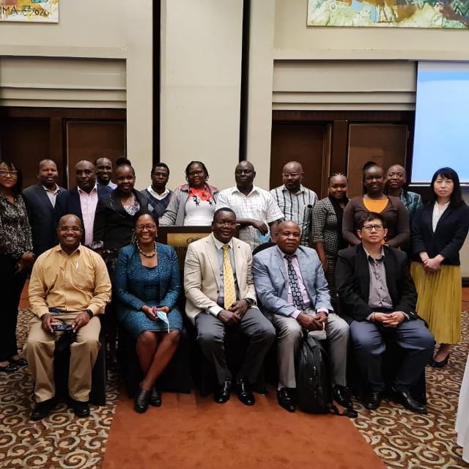
2022
HeSMA collaborated with UNICEF, MoH and County Departments of Health and other stakeholders to develop a curriculum, Competency Framework and Policy for Health Systems Managers
The Technical working group for professionalization of health
CDC
UNICEF
HeSMA
MoH
KMTC
CHAK
KCCB
Universities

Slide 11
Vision
......an effective body of knowledge, skills and practice that promote the highest level of quality health service delivery in Kenya and the region

Slide 12
Mission
To utilize systems approach to influence how health is delivered in Kenya and the region
To identify, advocate, lead in raising a generation of Health system Managers who will apply the systems thinking to respond to the health needs and opportunities in Kenya and the region
To establish and develop a body of knowledge, skills and competencies which will be an authority in the leadership, Management and Governance of Health Systems in Kenya and the region

Slide 13
KRA 1: Capacity for Health Managers
Obj 1: To bring together, provide means of cooperation and unite Health Systems Managers of all cadres and qualifications in Kenya and region.
Obj 2: Share collective opinions, views and decisions; conduct peer to peer reviews, mentor others on matters affecting health

Slide 14
KRA 2: Capacity for organizations
Obj 3: Provide technical and organizational leadership, management and governance support through best practices.
Obj 4: Provide audits and awards and model best practices in systems approach to health for member organizations

Slide 15
KRA 3: Advocacy on Health System issues
Obj 5: To enlighten and support members and their organizations of the various LMG approaches to Health for systems strengthening
Obj 6: Engage all relevant stakeholders to champion for policy, regulations and standards on health systems issues

Slide 16
Obj 7: Promote the principles of equity in health for health systems strengthening
Obj 8: Ensure recognition of health systems managers as integral professional in the health sector
Obj 9: Professionalization of health systems management in the Kenya and region

Slide 17
KRA 4:Networking and development
Obj 10: Cooperate with government, private sector and other professional bodies and development partners with similar objectives together or in part to support the mission and objectives of the association
      MOU/MOA
      PPP
      Joint Ventures
      Task forces and providing Technical capacity
      Consultancies

Slide 18
KRA 5: Build the Profession
Obj 11: Advocate for discipline, code of conducts and optimal performance of our members
    Regulation and enforcement through by-laws
    Recommendation and referrals

Slide 19
What we set Ourselves to achieve
Professionalize Health management and leadership
    Credible and effective association and programs
    Scheme of service
    Recognition and voice in health
Institutionalize Health Systems management
    Training and on Job professional growth
    Train and deploy more
    Association and an institute

Slide 20
Opportunity in the region provides best environment to influence health
    Regional status and membership
    Better foundation on health planning and systems design
Good representation in the health stakeholders Forums at all levels through county representatives
Of course we have to add value to members
    Professional, Monetary, non-financial rewards, exposure, networking etc

Slide 21
Governance structure
AGM-Individual members and corporate
Chairman
Appointee (ex- official)
Appointee
External- lawyer
Secretary
(CEO)
Vice Chairman
Treasurer
Appointee
(ex-official)
County Representatives
(43)
Special Committees
Credentialing, Capacity development,

Slide 22
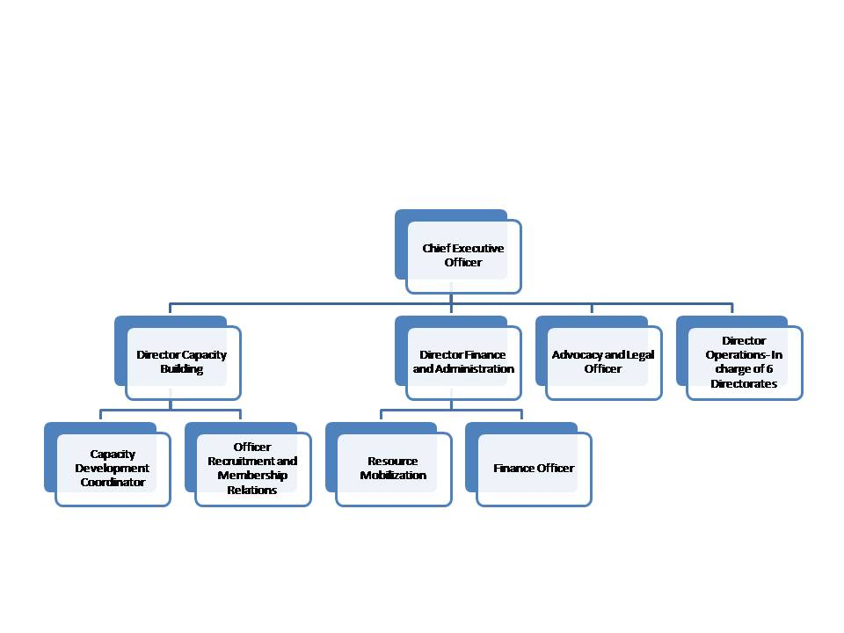
Management and operations

Slide 23
Nature
Professional Body registered by AG under society's Act of 1968
Membership is by subscription on an annual basis based on categories
      Student membership
      Professional
      Corporate
      Life, honorary, associate
Collegiate- A detailed program where regular members move to diplomate and finally to a fellow in HSM

Slide 24










Collaborating Organizations

Slide 25










Collaborating Training institutions

Slide 26
More details of achievement
Embarked on awareness, membership recruitment and establishment of SOPs
Established links with the Ministry Of Health and development partners
Development and operationalzed a 2, 3 year Strategic plan
Registered 1650 Health managers
Established Students clubs in Nairobi, Kenyatta and Kenya Methodist Universities geared towards development of the future generation health leaders with a system approach

Slide 27
Developed a draft scheme of service for Health Systems Managers through needs assessments, development of aims of objectives, administration and training scope of scheme, functions, grading structure and scope, provision of post, review of scheme, entry into the scheme, advancement, recognized qualification and Job and appointment specifications
Implementation of the Leadership Development Program especially on review of the projects done by the health managers in Embu, Makueni, Nakuru, Nairobi, Elgeyo Marakwet Counties

Slide 28
Establishment or resource content for health managers through interactive online resources under the website (www.hsm-kenya.org) and developed own website (www.hesma.or.ke) with all resources for health managers in Kenya including linkages with universities approved by Commission of University Education and the HeSMA to train health managers
Conducted the 2nd national health leadership assessment and organized the health and leadership congress in 2015 in Nairobi

Slide 29
Benchmarked with 5 health care management professional bodies in the world and developed a set of minimum set of knowledge, skills and attitudes that define the competencies and professional and ethical conduct to which managers should/are prescribe to.
Developed a capacity development program for Managers together with Northeastern State University with innovative online professional courses

Slide 30
Established guidelines for credentialing of members for professional certification with a framework, certification protocol, eligibility requirements, accredited (recognized) trainings and educational programs, professional obligations and standards for health systems managers, establishment of credentialing committees and process and set of code of conduct for health managers
Establishment of a mentorship program allied to ISEC and Give Back Global that is providing mentors from American College of Health executive with over 45000 members with up to 30 years of accumulated experience in health care management.

Slide 31
Launched a Credentialing program- Certified 8 healthcare managers (ACHE level)
Launched a mentorship and coaching program (wired4Excellence) in partnership with International Hospital federation
Opened an office for Horn of Africa in Hargeisa, Somali-land
Held meetings to find ways of establishing the an Institute Of Health Systems Management. Nominated Prof Moseley as the prinicipal

Slide 32
Areas Proposed for partnership
Professionalize health Governance Leadership And Management (advocacy and lobbying the GOK)
Building and scaling up of capacities in Managing Health facilities
Establishment of profession, standards, and career progression and certification

Slide 33
Use of best practices and “cross-pollination” and best practices within the region
Life long learning

Slide 34
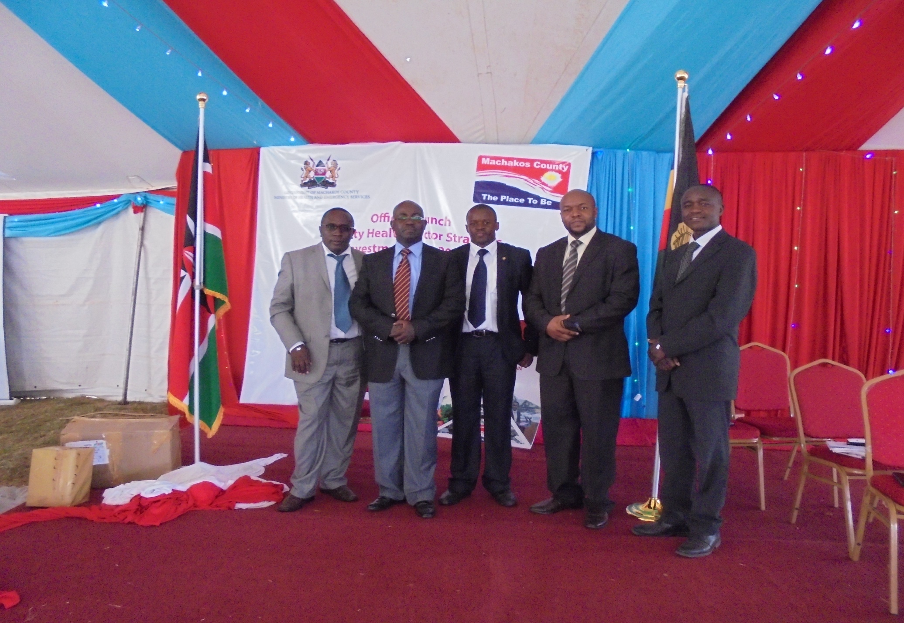
1st Health Summit for Machakos County

Slide 35
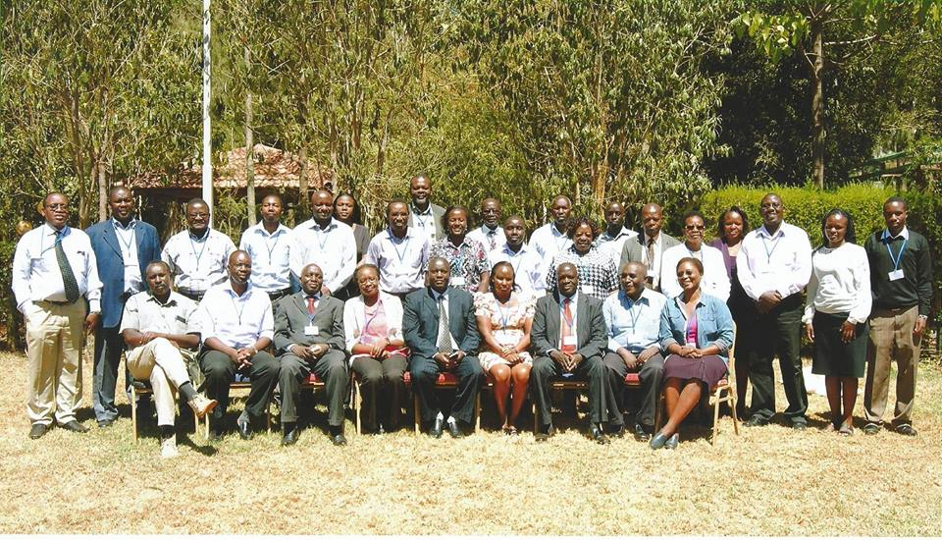
Moi University Training Programs

Slide 36
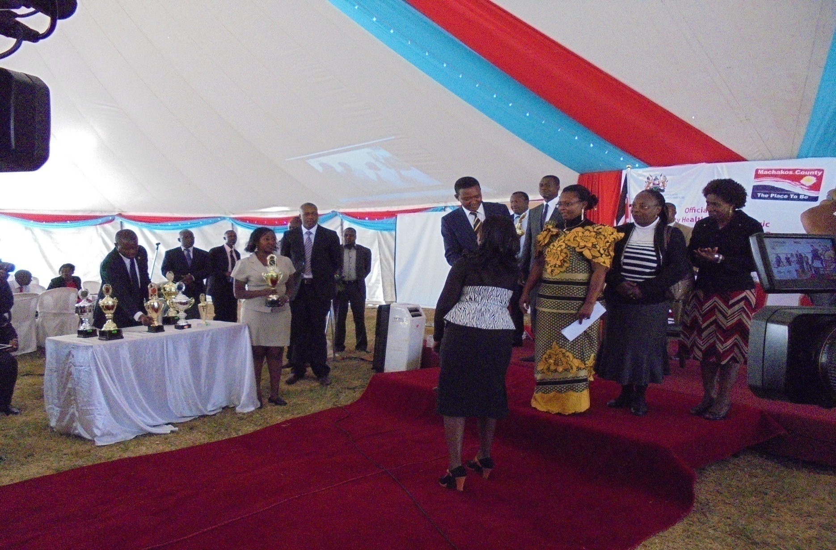
County Awards

Slide 37
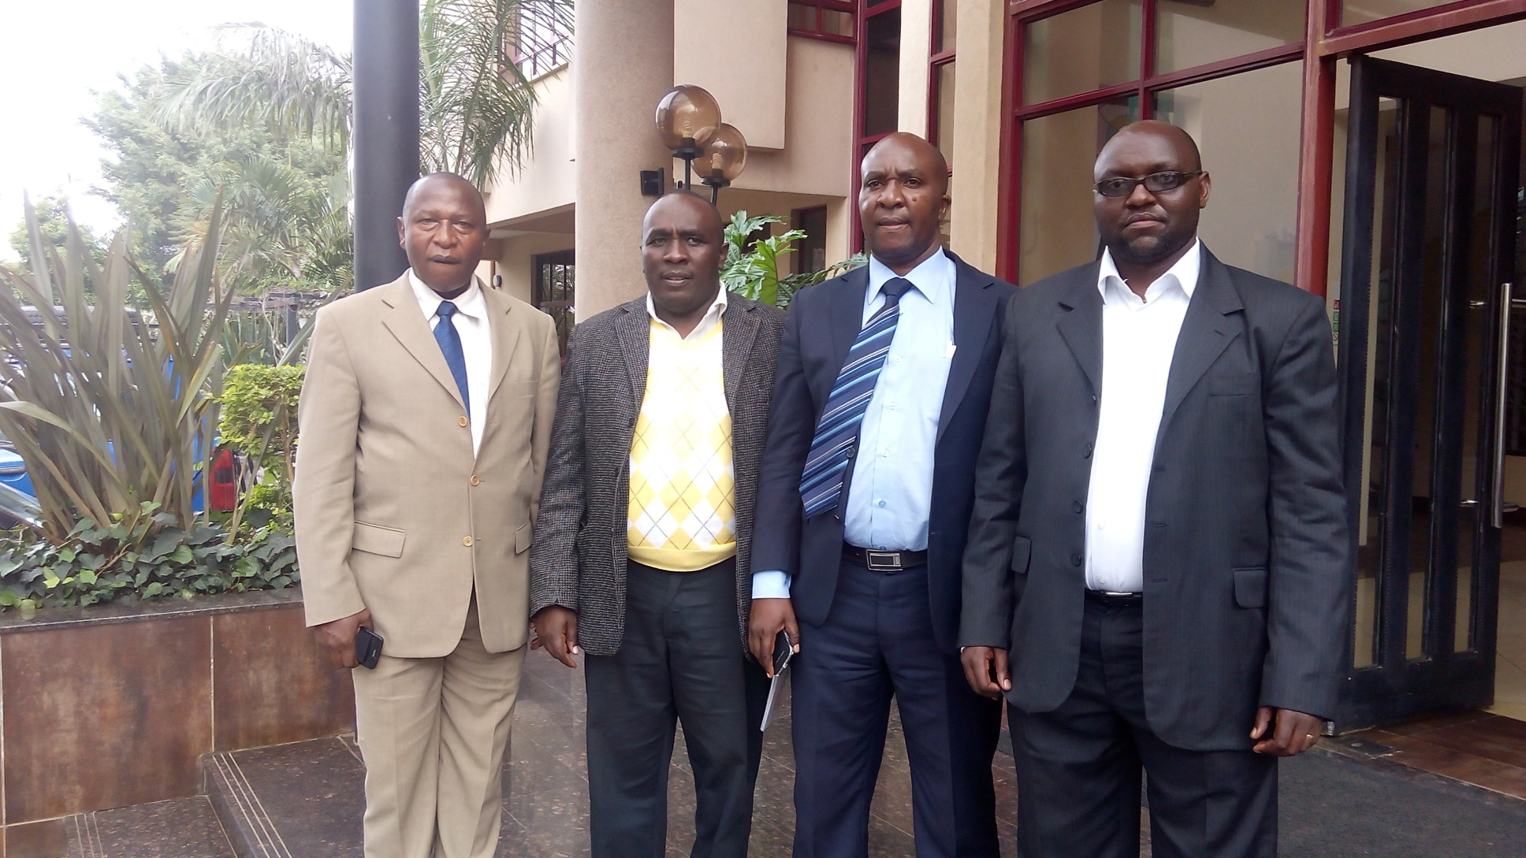
Uganda HeSMA liaison

Slide 38
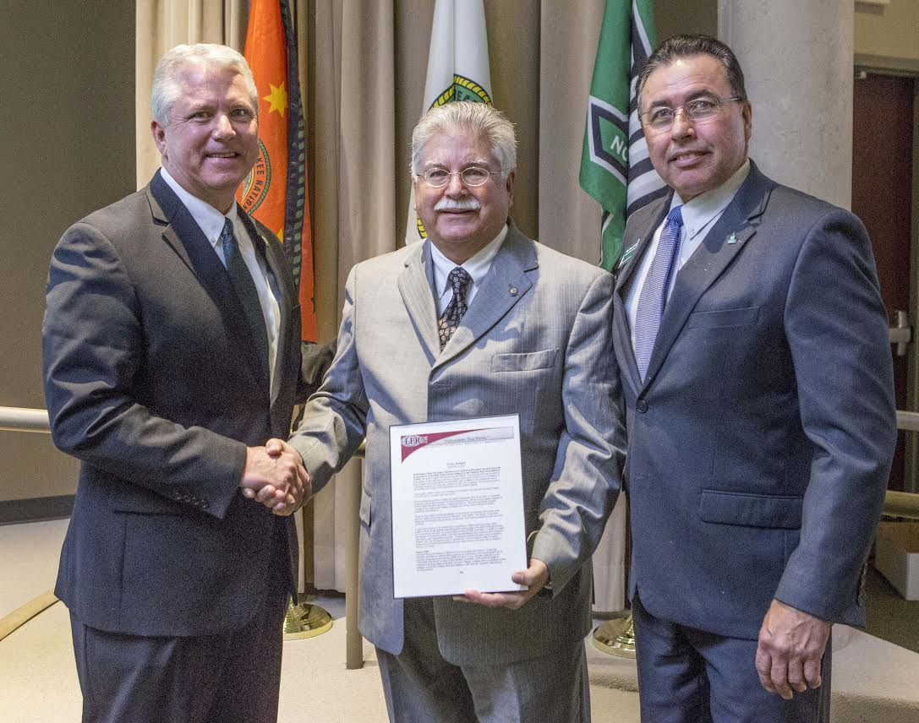
HeSMA-NSUOK receives LERN Award for the best online training program for Managers in Kenya, Uganda, Nigeria and now Aruba!

